Slide 1
MUSIC THEORY – LEVEL 3-4: Part 1
Compiled by Nicole Greggs, NBCT
Plantation Park Elementary School
Broward County, FL
Nicole.greggs@browardschools.com

Slide 2
ELEMENTS OF MUSIC

Slide 3
RHYTHM= DURATION
RHYTHM IS PATTERNS OF LONG AND SHORT SOUNDS.
EXAMPLES:

Slide 4
BEAT
THE STEADY PULSE OF MUSIC.
ALL NOTES ARE THE SAME LENGTH.

Slide 5
BEATS: WEAK OR STRONG?
METER | STRONG BEATS | WEAK BEATS
2/4 TIME | 1 | 2
3/4 TIME | 1 | 2, 3
4/4 TIME | 1, 3 | 2, 4
6/8 TIME | 1, 4 | 2, 3, 5, 6

Slide 6
METER/ TIME SIGNATURES
NOTES ARE GROUPED IN MEASURES.
THE METER TELLS YOU HOW THE BEATS ARE GROUPED.

Slide 7
RHYTHM
A BAR LINE IS PLACED AFTER EVERY ___ BEATS (DEPENDING ON METER’S TOP #). STRONG BEATS FALL AFTER EVERY BAR LINE.

Slide 8
BAR LINE & MEASURE

Slide 9
DOUBLE BARLINE (END OF A SONG)

Slide 10
REPEAT SIGN
(PLAY IT AGAIN!)

Slide 11
METER
THE METER (AKA TIME SIGNATURE- EG: 2/4, 3/4, 4/4, 6/8) TELLS:
HOW MANY BEATS ARE IN EACH MEASURE, AND
WHICH NOTE IS COUNTED AS 1 BEAT.

Slide 12
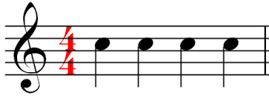
4/4 TIME SIGNATURE
TOP 4= 4 BEATS PER MEASURE;
BOTTOM 4= QUARTER NOTE =1 BEAT

Slide 13
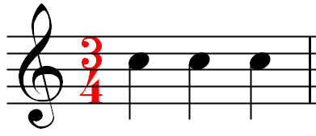
3/4 TIME SIGNATURE
TOP 3= 3 BEATS PER MEASURE;
BOTTOM 4= QUARTER NOTE =1 BEAT

Slide 14
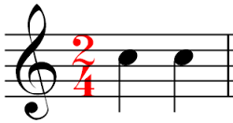
2/4 TIME SIGNATURE
TOP 2= 2 BEATS PER MEASURE;
BOTTOM 4= QUARTER NOTE =1 BEAT

Slide 15
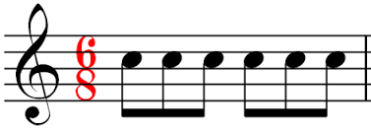
6/8 TIME SIGNATURE
TOP 6= 6 BEATS PER MEASURE;
BOTTOM 8= EIGHTH NOTE =1 BEAT

Slide 16
COMMON & CUT TIME

Slide 17
METER
THE FIRST BEAT OF A MEASURE IS ALWAYS THE STRONGEST, AND IS CALLED THE DOWNBEAT.

Slide 18
METER- DOWNBEAT

Slide 19
METER
THE LAST BEAT OF A MEASURE IS ALWAYS THE WEAKEST, AND IS CALLED THE UPBEAT.

Slide 20
METER- UPBEAT

Slide 21
CONDUCTING IN 2/4 TIME

Slide 22
CONDUCTING IN 3/4 TIME

Slide 23
CONDUCTING IN 4/4 TIME

Slide 24
CONDUCTING IN 6/8 TIME

Slide 25
CONDUCTING COMPARISON

Slide 26
NOTES ARE SOUND; RESTS ARE SILENCE

Slide 27
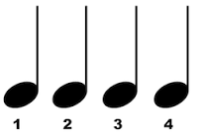
QUARTER NOTE- “TA”
1 BEAT OF SOUND (4/4)

Slide 28
2 EIGHTH NOTES- “TI-TI”
2 SOUNDS IN 1 BEAT

Slide 29
QUARTER REST- THINK “SH!”
1 BEAT OF SILENCE

Slide 30
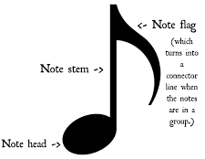
EIGHTH NOTE
1/2 BEAT OF SOUND (4/4)

Slide 31
EIGHTH NOTE
1 BEAT OF SOUND (6/8)

Slide 32
3 EIGHTH NOTES- “TRI-PLE-TI”
IN 6/8 TIME, EACH 8TH NOTE= 1 BEAT
TRI-PLE-TI TRI-PLE- TI TRI-PLE-TI TRI-PLE-TI

Slide 33
QUARTER NOTE- “TA”
2 BEATS OF SOUND (6/8)

Slide 34
DOTTED QUARTER NOTE
3 BEATS IN 6/8 TIME

Slide 35
HALF NOTE= “TWO-OO”
2 BEATS OF SOUND (4/4)

Slide 36
HALF REST= THINK “SH-SH”
2 BEATS OF SILENCE

Slide 37
DOTTED HALF NOTE= “THREE- EE- EE”
3 BEATS OF SOUND

Slide 38
WHOLE NOTE= “FOUR- OR- OR- OR”
4 BEATS OF SOUND

Slide 39
WHOLE REST= THINK “SH-SH-SH-SH”
4 BEATS OF SILENCE

Slide 40
4 SIXTEENTH NOTES= “WA-TER-MEL-ON”
-
4 SOUNDS IN 1 BEAT

Slide 41
MUSIC THEORY LEVELS 3-4
END OF PART 1- RHYTHM, METER, & CONDUCTING

Slide 42
MUSIC BEE STUDY SHEET
For a paper copy of this information, see the Music Bee Study Sheet received in Music Class from Mrs. Greggs.
This presentation covers starred (★) material on the study sheet.
You can watch this powerpoint on the internet by visiting Mrs. Greggs website www.musicmakerscamp.com & clicking on the PPE General Music Page. Or, make your own flashcards if you want to practice further.

Slide 43
GOT ALL THAT?
LET’S TRY IT AGAIN!

