Slide 1
MUSIC THEORY – LEVEL 3-4: Part 2
Compiled by Nicole Greggs, NBCT
Plantation Park Elementary School
Broward County, FL
Nicole.greggs@browardschools.com

Slide 2
STAFF

Slide 3
TREBLE CLEF (HIGH NOTES)
AKA “G CLEF”

Slide 4
BASS CLEF (LOW NOTES)
AKA “F CLEF”

Slide 5
GRAND STAFF (FOR PIANO)

Slide 6
PITCH
THE HIGHNESS OR LOWNESS OF A MUSICAL SOUND IS THE PITCH!
PITCH IS DIFFERENT FROM VOLUME (HOW LOUD/SOFT A SOUND IS.)

Slide 7
PITCH IS SHOWN ON THE STAFF.
THE STAFF IS A GRAPH OF HOW HIGH/LOW NOTES ARE, AND HOW LONG THEY LAST.

Slide 8
TREBLE STAFF LINES
“EVERY GOOD BOY DOES FINE-”
RHYMES WITH LINE!

Slide 9
TREBLE STAFF SPACES
“F- A- C- E- “FACE” RHYMES WITH SPACE!

Slide 10
TREBLE STAFF COMBINED LETTER NAMES

Slide 11
TREBLE STAFF COMBINED LETTER NAMES
LETTERS GO IN ALPHABETICAL ORDER FROM LOWEST TO HIGHEST- DON’T SKIP ANY LINES OR SPACES.

Slide 12
MELODY
THE TUNE OF A SONG IS THE MELODY!
MELODY HAS RHYTHM AND PITCH.

Slide 13
BREATH MARK

Slide 14
PHRASE- A MUSICAL THOUGHT

Slide 15
PHRASE MARK

Slide 16
SOLFEGE & HAND SIGNS

Slide 17
WHY SOLFEGE?
SOLFEGE helps us identify pitch patterns in songs.
Identifying pitch patterns make music easier to understand, memorize, and perform correctly.
SOLFEGE helps us learn to play tunes we hear by ear- that is, without written music.

Slide 18
VOCAL REGISTERS

Slide 19
RANGE
THE COLLECTION OF NOTES ON THE STAFF THAT A VOICE OR INSTRUMENT CAN PRODUCE. FOR EXAMPLE:

Slide 20
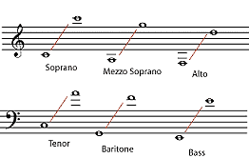
SOPRANO
THE HIGHEST VOCAL RANGE IN A CHOIR OR INSTRUMENT FAMILY.

Slide 21
ALTO
THE SECOND HIGHEST VOCAL RANGE IN A CHOIR OR INSTRUMENT FAMILY.

Slide 22
TENOR
THE UPPER MALE VOCAL RANGE IN A CHOIR OR INSTRUMENT FAMILY- USUALLY SUNG BY MEN:

Slide 23
BARITONE
THE SECOND LOWEST VOCAL RANGE IN A CHOIR OR INSTRUMENT FAMILY- SUNG BY MEN.

Slide 24
BASS
THE LOWEST VOCAL RANGE IN A CHOIR OR INSTRUMENT FAMILY- SUNG BY MEN.

Slide 25
NATURAL
(CANCELS A SHARP OR FLAT)

Slide 26
FLAT
(LOWERS⬇ PITCH BY ½ STEP)

Slide 27
SHARP
(RAISES⬆ PITCH BY ½ STEP)

Slide 28
DOUBLE FLAT
(LOWERS⬇ PITCH BY 2 HALF-
OR 1 WHOLE- STEP.)

Slide 29
DOUBLE SHARP
(RAISES⬆ PITCH BY 2 HALF-
OR 1 WHOLE- STEP.)

Slide 30
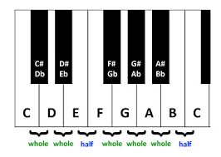
KEYBOARD BASICS
HALF STEP (H)= ON THE PIANO, FROM ONE KEY TO THE VERY NEXT KEY UP OR DOWN.

Slide 31
KEYBOARD BASICS
WHOLE STEP (W)= ON THE PIANO, 2 HALF STEPS IN THE SAME DIRECTION.

Slide 32
THE PIANO KEYBOARD
Has patterns of 2 then 3 black keys between white keys.

Slide 33
THE PIANO KEYBOARD
The note to the LEFT of each set of 2 black keys is C.

Slide 34
THE PIANO KEYBOARD
Letters go in ABC order LEFT TO RIGHT. There are only 7 REPEATING letters in the music alphabet: A-B-C-D-E-F-G.

Slide 35
THE PIANO KEYBOARD
Each black key has 2 names: the left note sharp # and the right note flat.

Slide 36
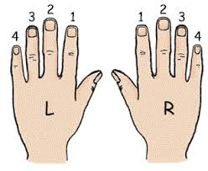
THE PIANO KEYBOARD
FINGERS ARE NUMBERED AS FOLLOWS:
3
3
4
2
2
4
5
5
1
1

Slide 37
RECORDER BASICS
LEFT HAND ON TOP,
RIGHT HAND BELOW.
COVER HOLES COMPLETELY,
DON’T OVERBLOW!
LEFT
HAND
RIGHT
HAND

Slide 38
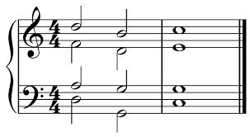
HARMONY
2 OR MORE NOTES HEARD TOGETHER IN A PLEASING WAY.

Slide 39
MUSIC BEE STUDY SHEET
For a paper copy of this information, see the Music Bee Study Sheet received in Music Class from Mrs. Greggs.
This presentation covers starred (★) material on the study sheet.
You can watch this powerpoint on the internet by visiting Mrs. Greggs website www.musicmakerscamp.com & clicking on the PPE General Music Page. Or, make your own flashcards if you want to practice further.

Slide 40
GOT ALL THAT?
LET’S TRY IT AGAIN!

